Slide 1
R1 arm training
Reach, grasp, lift, hold and throw
Learning from rewards, with no scripted teacher or DAgger.
65% nearby sequence success. Wider grasping remains limited.
MuJoCo simulation
October 26, 2026
Notes:
Progress report as of October 26, 2026. Nearby success is65/100 from full_throw_dynamic_20261026/report.json. All results are simulation. Previous IEEE-style presentation provides the visual reference. The stopped full residual PPO run has not met the50% wider-placement target.

Slide 2
Learning method
SAC acquisition
Soft Actor-Critic learns feedback commands for reaching and hand closure from physical rewards [1].
CEM motions
The cross-entropy method samples motion parameters, scores episodes and refits toward better candidates [2].
Residual PPO
A later experiment learns corrections around the preserved sequence during reaching, lifting and throwing [3].
Contribution
The R1 setup combines established methods, physical rewards and skill reuse. These optimizers are established algorithms.
Methods [1]–[3]. R1 implementation [7].
2
Notes:
[1] https://proceedings.mlr.press/v80/haarnoja18b.html [2] https://cdn.aaai.org/ICML/2003/ICML03-068.pdf [3] https://arxiv.org/abs/1707.06347 . Local sources: grasp_env.py, focus_lift.py, full_throw.py, full_residual_env.py, train_residual_ppo.py. Acquisition base has1.2M interactions. Focused lift uses18parameters (3knots×6channels); the throw has its own parameterized motion. CEM is reward-based policy search, distinct from gradient actor-critic learning.

Slide 3
Physical task and success criteria
Grasp
The thumb and at least one other finger contact the ball. The ball remains a free body under full gravity.
Lift and hold
Raise the ball at least 3 cm, clear the support and maintain a stable stationary hold before throwing.
Valid throw
Release forward at least 0.4 m/s. Require 0.1 s of free flight and at least 20 cm forward travel to first landing.
Collision accounting
A complete success requires no torso collision or disallowed ball contact. Every evaluated reset counts.
The full sequence checks a one-second hold before the throw.
Project records [7]
3
Notes:
Sources: full_throw.py, stable(), prefix(), episode(); grasp_env.py. Full-sequence hold has20controls at20Hz, requires thumb and another finger, unsupported lift>=.03m, ball speed<.2m/s, ball contacts subset of fingers/palm. Throw vx>=.4m/s, airborne>=.1s, forward release-to-first-landing displacement>=.2m, first landing cannot be the hand. Separate focused lift evaluation used5s stationary hold, a different protocol. No weld, teleport or external support during execution.

Slide 4
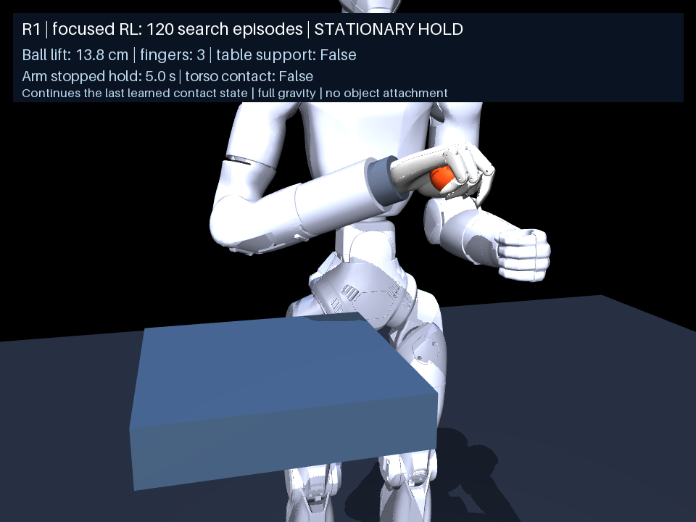
Learned lift and stationary hold
13.8 cm
demonstration lift height
120 focused CEM search episodes produced a lift followed by a five-second stationary hold.
Separate evaluation: 20/30 successes
from nearby contact continuations.
Project records [7]
4
Notes:
Video: focused_hold_lift/lift_and_hold_seed8800000.mp4. hold_report.json: training-state final lift.137750139m,5s stationary hold. Generalization result20/30 uses fresh nearby contact-state continuations reached by the acquisition policy. It is not30arbitrary wider resets. The13.8cm is one demonstration, not an evaluation mean.

Slide 5
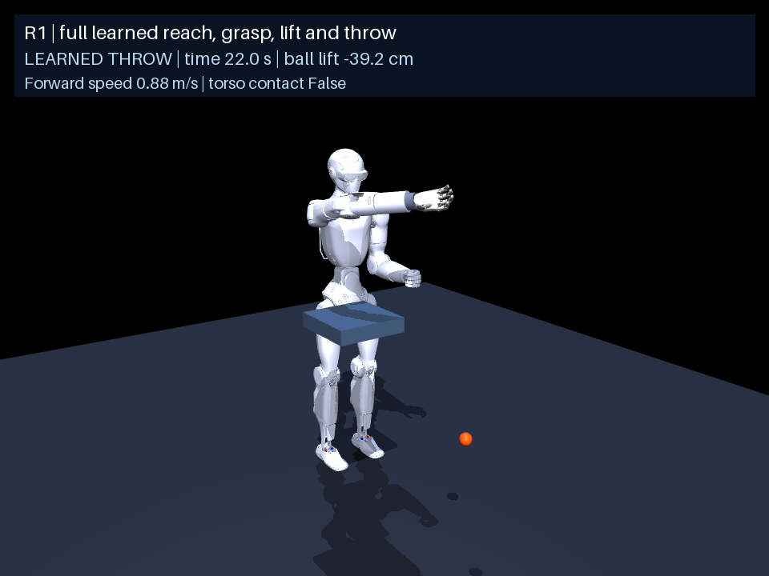
Complete reach-to-throw demonstration
35.0 cm
forward travel in this episode
One continuous simulation executes acquisition, lift, hold, acceleration and release.
Distance runs from release
to the first landing.
5
Notes:
Video: full_throw_dynamic_20261026/full_throw_seed10700022.mp4. report.json near row seed10700022, release-to-first-landing forward range.3501099592726937m. Demonstration of the preserved selected sequence, not the stopped residual policy. Native full physics, no reset between phases. The episode includes1s stable hold before throw.

Slide 6
Verified full-sequence results
Metric | Nearby starts | Wider starts
Placement spread | 15 mm | 80 mm
Complete successes | 65 / 100 (65%) | 3 / 50 (6%)
Lift successes | 66 / 100 (66%) | 4 / 50 (8%)
Torso collisions | 0 / 100 | 0 / 50
Successful nearby throws: 36.0 cm mean forward range, 43.9 cm maximum.
All reset episodes count. The 50% wider-placement target remains unmet.
6
Notes:
Source [7]: full_throw_dynamic_20261026/report.json. Selected controller uses physical_grasp_temporal/after_training.zip, focused_hold_lift/best_policy.npz and full_throw_dynamic_20261026/best_policy.npz. Nearby100 seeds10700000–10700099. Wide50seeds10800000–10800049, verify exactsource rows. Mean successful near range.3604935835192315m, max.43930669464376126m. Spread is the per-coordinate reset sampling parameter (uniform±spread before rejection of penetrating spawns), not Euclidean hand-to-ball distance or a certified reachable radius. Different test sample sizes shown explicitly.

Slide 7
Residual PPO improvement experiment
Starting point
Keep the earlier SAC and CEM sequence frozen. Train a bounded residual action on top of its commands.
Training scope
Correct acquisition, lift and throw. Keep stationary targets during the hold and flight observation phases.
CPU training
Use six parallel simulation environments and a placement curriculum from 15 mm to 80 mm.
Stopped run
Stop at 959,040 of 2 million planned interactions. Preserve the latest checkpoint and best validation checkpoint.
The experiment did not establish an improvement over the selected controller.
PPO [3]. Experiment records [7].
7
Notes:
Source: full_residual_ppo_wide_20261026/config.json, stop_summary.json, status.json, history.json, source_snapshot/train_residual_ppo.py and full_residual_env.py. Actor128×128, learning rate1e-4, gamma.995, GAE1, PPOclip.05, targetKL.005. Residual scale.25to2depends on initial placement context; native final actions clipped[-1,1]. Previous acquisition-only PPO provides actor latent features, correction output initializedzero. No teachers, DAgger or imitation loss. Clean checkpoint stop at959040.

Slide 8
Where the sequence fails
Diagnostic on best checkpoint | Episodes | Rate
Opposing finger contact | 4 / 24 | 16.7%
Valid lift and hold | 2 / 24 | 8.3%
Complete throw | 1 / 24 | 4.2%
Dropped object | 12 / 24 | 50.0%
Mean distance at lift start: 17.9 cm (episodes reaching that phase).
Reused validation starts. These counts diagnose failure, not final performance.
9
Notes:
Source: full_residual_ppo_wide_20261026/stage_diagnostics.json, best_wide.zip rerun on24fixed validation seeds15200000–15200023. Opposedcontact4everand4at240boundary, validlift2,throw1,drops12,torso0. Mean boundarydistance.17903014663973285m across episodes reaching240; some earlydrop episodes have no boundarymeasurement. Rows are different measurements on the same episodes and must not be summed. Success nested contact/lift/throw, drops separate. Diagnostic checkpoint can differ from last checkpoint.

Slide 9
Next experiments
Reachability audit
Measure feasible grasp poses and joint limits across wider starts. Retain every start in the existing benchmark.
Short skill pilots
Train grasp-and-lift separately and test readiness-based phase changes. Compare thumb and finger control options.
Replay and curriculum
Test SAC on shorter tasks. Expand placements by performance and consider HER with valid object goals [4].
Sequence evaluation
Reconnect the preserved throw after lift reliability improves. Test the complete sequence on 100 fresh wider starts.
Learned skill termination [5] is a candidate. No new long run is active.
10
Notes:
Proposals from ALTERNATIVE_TRAINING_PLAN.md, not implemented results. [4] HER: https://arxiv.org/abs/1707.01495 supports off-policy goal relabeling. Existing desired_goal is a moving hand target; lift HER requires a new consistent object-goal interface and recomputable rewards preserving grip/hold/collision constraints. [5] Option-Critic https://arxiv.org/abs/1609.05140 motivates learning optiontermination. A manually sensed readiness transition is an alternative, not identical to learned optiontermination. No demonstrations or teacheractions required by the proposal. Use small matchedbudget pilots before longtraining.

Slide 10
Project status
The complete movement works near familiar placements.
The selected controller achieves 65/100 nearby successes and 3/50 wider successes. The wider 50% target remains unmet.
The stopped PPO experiment preserves useful checkpoints and diagnostics. Grasp acquisition is the next training priority.
11
Notes:
Summary of [7]: full_throw_dynamic_20261026/report.json, selected_models.json, full_residual_ppo_wide_20261026/stop_summary.json and stage_diagnostics.json. The selected controller is unchanged. Latest experiment stopped by user; no active replacement training job. All results simulationonly.

Slide 11
References
[1]
T. Haarnoja, A. Zhou, P. Abbeel, and S. Levine, “Soft actor-critic: Off-policy maximum entropy deep reinforcement learning with a stochastic actor,” in Proc. ICML, vol. 80, 2018, pp. 1861–1870.
[2]
S. Mannor, R. Rubinstein, and Y. Gat, “The cross entropy method for fast policy search,” in Proc. ICML, 2003, pp. 512–519.
[3]
J. Schulman et al., “Proximal policy optimization algorithms,” arXiv:1707.06347, 2017.
[4]
M. Andrychowicz et al., “Hindsight experience replay,” in Advances in Neural Information Processing Systems, vol. 30, 2017.
[5]
P.-L. Bacon, J. Harb, and D. Precup, “The option-critic architecture,” in Proc. AAAI, vol. 31, no. 1, 2017.
[6]
MuJoCo, “Computation,” MuJoCo Documentation. Accessed: Oct. 26, 2026. [Online]. Available: https://mujoco.readthedocs.io/en/stable/computation/
12
Notes:
[1] https://proceedings.mlr.press/v80/haarnoja18b.html [2] https://cdn.aaai.org/ICML/2003/ICML03-068.pdf [3] https://arxiv.org/abs/1707.06347 [4] https://arxiv.org/abs/1707.01495 [5] https://arxiv.org/abs/1609.05140 [6] https://mujoco.readthedocs.io/en/stable/computation/ [7] /Users/cesarpascal/Documents/Training/real_r1_arm_policy/rl_grasp, especially selected_models.json, grasp_env.py, focus_lift.py, full_throw.py, full_residual_env.py, train_residual_ppo.py and cited run JSONs. [1]–[3] describe established algorithms used. [4]–[5] motivate future experiments, not methods already validated in the stopped run.

